Slide 1
Pereiaslav-Khmelnytskyi
Hryhorii Skovoroda
State Pedagogical University
Oksana Kovtun

Slide 2
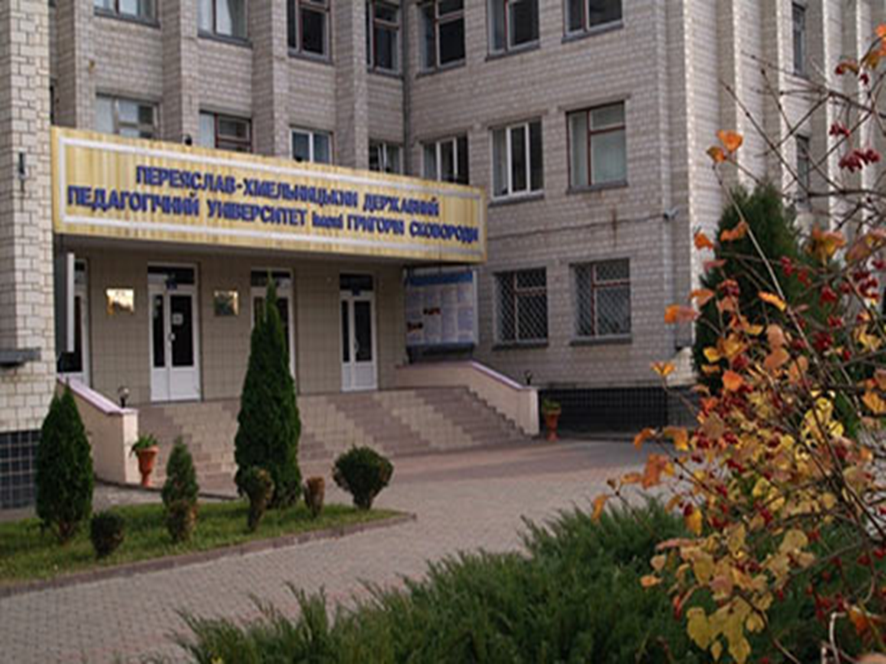
Aims of the University
SHEI “Pereiaslav-Khmelnytskyi Hryhorii Skovoroda State Pedagogical University” moves towards in the direction of development of internationalization strategy of educational process of University, Europeanization of Ukrainian society.
According to these aims, the University uses all opportunities to obtain the international experience in various fields of education and science, namely:
participating in academic mobility programs;
developing and implementing various educational projects;
organizing numerous conferences, symposiums, round tables, international summer camps and etc.

Slide 3
Additional aims of our activities are:
joint implementation of humanitarian projects;
organization of youth meetings of Ukrainian and foreign students;
organization and conducting of programs and projects assisting of skills development of the youth in social, public and educational spheres;
strengthening connections between students all over the world through the meetings with colleagues, openly presenting aspects of daily life, social cultures, family traditions in the countries;
publishing articles in foreign journals;
exchange of scientific materials, publications, and information; exchange of educational products;
volunteer collaboration for teachers and students;
organizing and conducting of master-classes and short-term courses for students;
arranging of study tours for the students and university staff;
organizing conferences/symposiums to bring experts from diverse disciplines together.

Slide 4
Internationalization strategy of the University
The internationalization strategy of the University has already developed and implemented. All these actions are directed to integration of our University to the European educational space.
Main priorities:
assistance of European integration and democratic trends of development of Ukrainian society;
strengthening of international dimension in the spheres of higher education;
quality improvement all sectors of education through extension international scientific cooperation, establishment of administrative staff mobility, strategic partnerships;
increasing opportunities for students of higher educational institution to improve their employability through internships and organization of the academic mobility.
The activities are implemented in accordance with the mission of the university, its development and internationalization strategies.

Slide 5
History of the University
The history of the institution dates to 1702, when the Elementary Spiritual School, a literacy school for teaching clergy children, was opened.
Pereiaslav Collegium, founded in 1738, was one of the first higher educational institutions of the Left Bank of Ukraine, where educational activities were carried out on the pattern of Kyiv-Mohyla Academy. The Pereiaslav Collegium is known for teaching poetry professor Hryhorii Skovoroda.

Slide 6
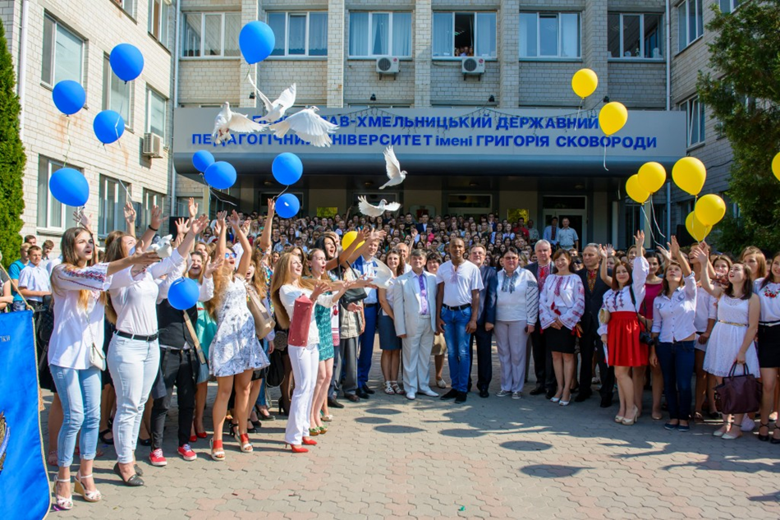
Considering the ancient educational traditions, our educational institution was founded on June 23, 1986, which began its activity as a branch of Kyiv Pedagogical Institute named after A.M. Horkyi.
By the Cabinet of Ministers’ order of February 28, 2002 “On creation of Pereiaslav-Khmelnytskyi Hryhorii Skovoroda State Pedagogical University” our Higher Educational Institution became an independent university.
Currently, the university is being renamed. Now our university will be called “Hryhorii Skovoroda University in Pereiaslav”.

Slide 7
Viktor Kotsur
Rector of the University
Academician of the National Academy of Pedagogical Sciences of Ukraine
Deputy Chairman of the National Union of Local Historians of Ukraine
Honored Worker of Education of Ukraine
Doctor of Historical Sciences, Professor

Slide 8
Educational and scientific activities

Slide 9
Structure
Faculty of Humanitarian and Natural Education and Social Technologies
Faculty of Technological and Mathematical Education
Faculty of Historical and Socio-Psychological Education
Faculty of Pedagogical Education, Management and Arts
Faculty of Financial and Economic and Vocational Education
Faculty of Physical Education, Sport and Health Care
Faculty of Ukrainian and Foreign Philology

Slide 10
Bachelor Degree Specialties
012 Pre-school education
013 Primary education
014 Secondary education (Labor training and technology)
014 Secondary education (Physical training)
014 Secondary education (Musical arts)
014 Secondary education ( Fine arts)
014 Secondary education (History)
014 Secondary education (Ukrainian language and literature)
014 Secondary education (Language and literature (English))
014 Secondary education (Language and literature (German))
014 Secondary education (Language and literature (French))
014 Secondary education (Biology and human health)
014 Secondary education (Biology)
014 Secondary education (Geography)
014 Secondary education (Mathematics)
015 Vocational education (Scientific Disciplines of Documentation)
015 Vocational education (Commodity science)
015 Vocational education (Printing and publishing)
015 Vocational education (Service sector)
015 Vocational education ( Labor safety)
015 Vocational education (Food technology)
035 Philology
051 Economics
055 Political Science
053 Psychology
071 Accounting and Taxation
072 Finance, Banking and Insurance
073 Management
071 Social Work
281 Public Management and Administration

Slide 11
Master Degree Specialties
011 Educational, pedagogical sciences
012 Pre-school education
013 Primary education
014 Secondary education (Labor training and technologies)
014 Secondary education (Physical training)
014 Secondary education (Musical arts)
014 Secondary education ( Fine arts)
014 Secondary education (History)
014 Secondary education (Ukrainian language and literature)
014 Secondary education (Language and literature (English))
014 Secondary education (Language and literature (German))
014 Secondary education (Biology)
014 Secondary education (Biology and human health)
014 Secondary education (Geography)
014 Secondary education (Mathematics)
015 Vocational education (Scientific Disciplines of Documentation)
015 Vocational education (Commodity science)
015 Vocational education (Service sector)
015 Vocational education ( Labor safety)
051 Economics
052 Political Science
053 Psychology
071 Accounting and Taxation
072 Finance, Banking and Insurance
073 Management
071 Social Work

Slide 12
Ph.D. Specialties
011 Educational, pedagogical sciences
014 Secondary education (Ukrainian language and literature)
015 Vocational education
017 Physical Training and Sports
032 History and Archaeology
033 Philosophy
035 Philology
051 Economics
053 Psychology
071 Accounting and Taxation
072 Finance, Banking and Insurance

Slide 13
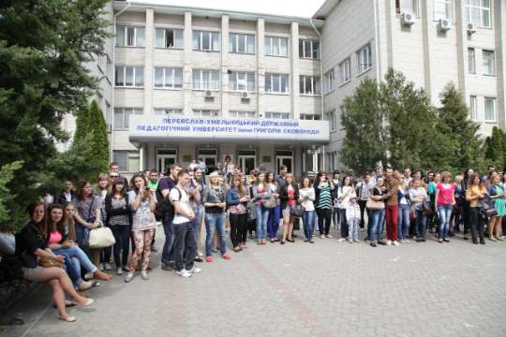
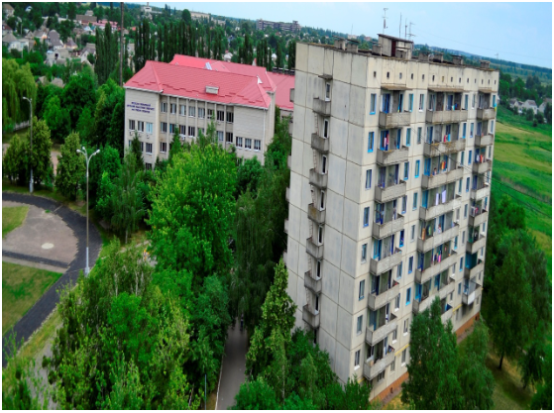
The University has 3 educational buildings, 2 student dormitories, a library, reading rooms, teaching laboratories, 9 computer classes, linguaphone rooms, a student canteen, an assembly hall, a stadium, a sports complex, and a medical center.
There are 2 research centers, 15 scientific and methodological laboratories, 2 research laboratories, 15 scientific schools, postgraduate studies and doctoral studies at the University.

Slide 14
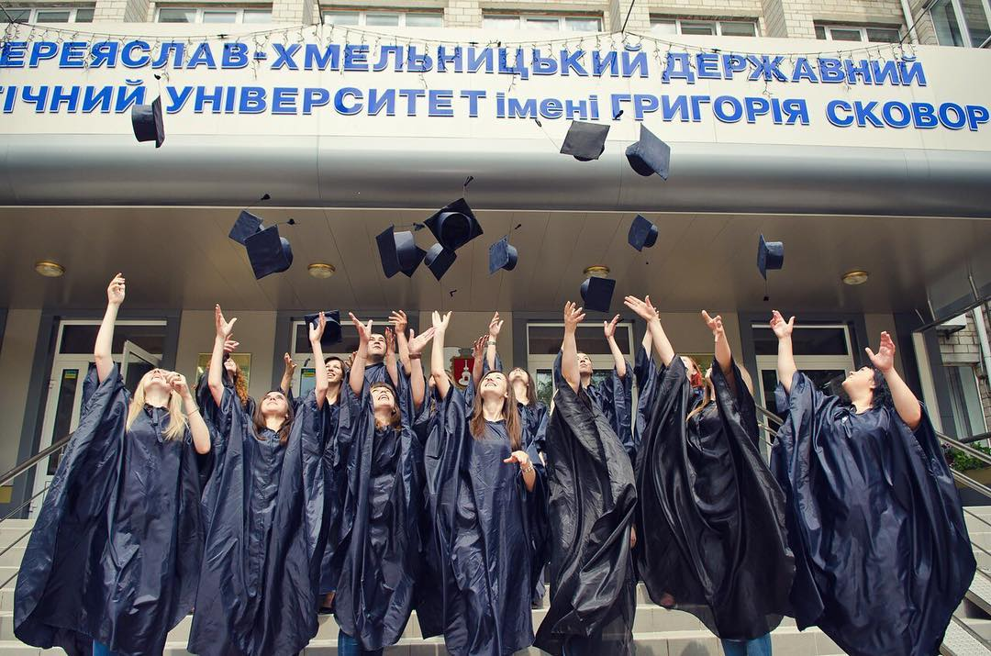
The results of research are published in 10 collections of the University: «Humanitarium», «Scientific Notes on Ukrainian History», «Pereiaslav Chronicle», «Psycholinguistics», «Theoretical and Didactic Philology, University», «Technological Education», «Professional Education», «Socium. Document. Communication: a collection of scientific articles».
The tool for supporting the development of the scientific and information environment is the electronic archive «Institutional Repository» (ePHSHEIR), which collects, systematizes and stores information that provides long-term open access to the results of scientific research.

Slide 15
International activities AND PROJECTS

Slide 16
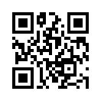
Web-site of the International Relations Department
The Department of International Relations faithfully works to implement the university’s internationalization strategy. The department focuses on the development, expansion and strengthening of international relations and the authority of the university in the global educational and scientific community.
The department carries out the function of establishing international relations with foreign partners: institutions of higher, secondary and vocational education, foundations, public organizations, associations and other institutions, performs coordination and advisory functions, is responsible for the organization and control of international programs and academic mobility of the University.
https://doir.phdpu.edu.ua/

Slide 17
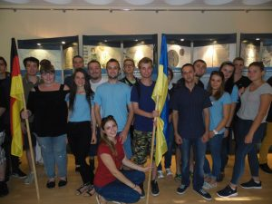
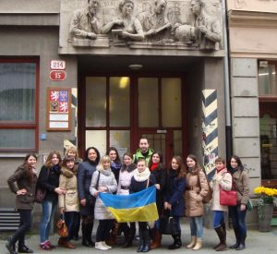
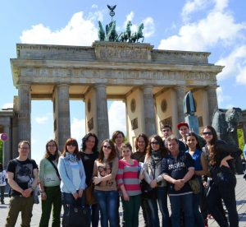
Academic mobility programs
Several academic mobility programs are implemented in cooperation with the Masaryk University (Czech Republic), Gdańsk University (Poland), University of Western Bohemia in Plzen (Czech Republic), and Hochschule Magdeburg-Stendal (Germany).

Slide 18
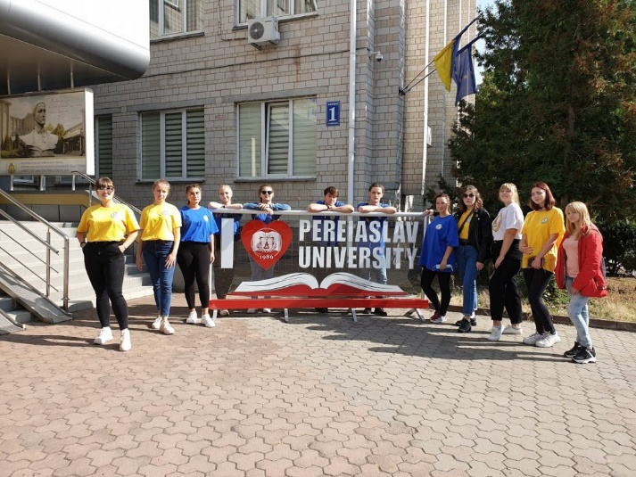
Project of the program “Student Academic Mobility (SAM) Ukraine”
The British Council jointly with the Ministry of Education and Science of Ukraine implements a three-year program of all-Ukrainian academic mobility “SAM Ukraine”. This program is one of the components of the EU program “House of Europe” and is implemented during 2020-2022.
The program “SAM Ukraine” is intended to promote interregional academic cooperation between universities and the cultural dialogue between young people from short-term academic mobility within Ukraine.
Our SHEI jointly with the Donbas State Pedagogical University were among the winners for the implementation of mobility. Consequently, from September 21 till October 18, 2020 24 students of our universities 2nd and 3rd year of the educational level of a bachelor of the following specialties: 013 “Primary education”, 012 “Preschool education”, 231 “Social work” participate in the program of student academic mobility .

Slide 19
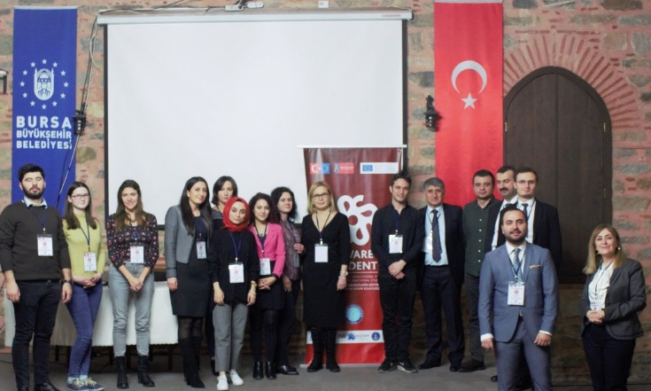
ERASMUS+ Youth KA 2 project “Adaptation Guide to Educational System & Social Life for International Students”
Project goals:
Creating a mobile application that will ease the education life and social adaptation of international students.
Launching a web page that will give information about the project work to the public and provide the visibility / downloading of the intellectual outputs.
Producing a guidebook for the use of the mobile application.
Disseminating the intellectual outputs produced with partner NGOs, relevant institutions and organizations.
Ensuring the sustainability of the project by collecting information about the problems and suggestions of international students through workshops.
Making international dissemination studies for the project outputs.
The duration of the project is 24 months: 12/11/2019-31/05/2021.
Aim of the project: adapting and improving the quality of life of students studying abroad.

Slide 20
The Affiliated Diploma
Due to the agreement an agreement between our University and the Swiss Montreux Business School (SMBS), SMBS recognize Bachelor’s and Master’s degrees diplomas that are awarded by our University.
In the context of international cooperation between our University, Swiss Montreux Business School (SMBS) and SMBS representation in Ukraine our students have an opportunity to obtain two diplomas (Ukrainian and European).
The affiliated diploma is a Bachelor’s or Master’s diploma issued by SMBS to Ukrainian students after defending their diploma project simultaneously with the Bachelor’s or Master’s diploma of SMBS.
SMBS, according to the signed agreement, awards the Bachelor’s or Master’s degree according to the results of all disciplines in accordance with the curriculum of Pereiaslav-Khmelnytskyi Hryhorii Skovoroda State Pedagogical University, which is pre-regulated with SMBS.

Slide 21
The project “New Ukrainian school – a new teacher”
The project “New Ukrainian school – a new teacher” is being implemented with the support of the International Foundation “Renaissance”.
The participant of the project from our Higher Education Institution is the Faculty of Pedagogical Education, Management and Arts.
The project is designed for 3 years. Set objectives of the project:
conducting an evaluation of educational programs in partner universities;
development of criteria and indicators of their quality;
development of a “professional teacher profile” and recommendations for improving educational programs;
introduction of innovative teaching methods;
creation of a new type of educational institutions.

Slide 22
ERASMUS+ KA2 project “Modernization of pedagogical higher education by innovative teaching instruments – MoPED”
Project goals:
Development of modern teaching materials on STEAM subjects teaching methodology;
To develop and accredit 18 semester disciplines included in the curricula of Ukrainian HEI and their accreditation at the institutional level, which will ensure the modernization of the Bachelor’s and Master’s degree programs of each university in Ukraine;
Providing a series of trainings for 450 teachers of Ukrainian HEI – project partners;
To establish effective cooperation between European and Ukrainian universities, school teachers and their associations to strengthen the internationalization, knowledge transfer and academic capacity;
Creation of an “Innovation classroom” in each of the Ukrainian HEI, partners of the Project, which will be considered as an educational space of the XXI century, based on the best European practices.
The purpose of the project is to modernize the curricula of pedagogical higher education institutions in Ukraine using modern practices and teaching methodologies involving ICT and modern research methods of results.

Slide 23
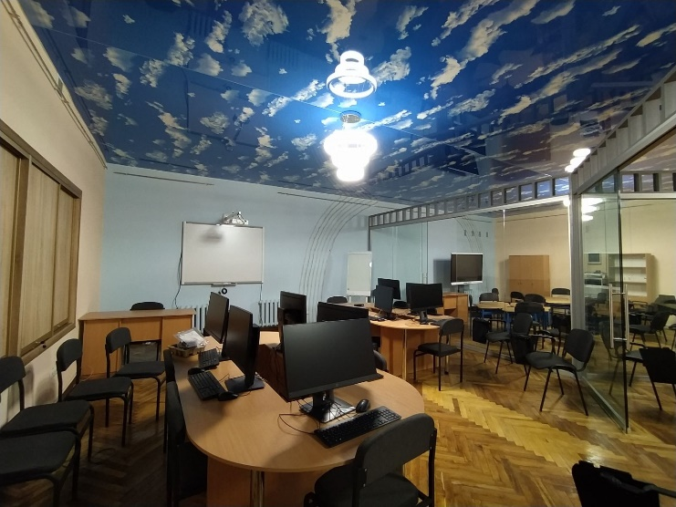
The results of the MoPED project
Project results:
developed modern teaching materials on the implementation of STEAM education elements in the educational process;
developed and accredited 18 semester disciplines included in the curricula of HEI of Ukraine, which will ensure modernization of educational programs of “Bachelor” and “Master” levels of each university in Ukraine;
conducted a series of trainings for teachers of Ukrainian HEI, partners of the project, and for teachers of primary, secondary, and vocational educational institutions;
created “Innovative classroom” (ICR) in each Ukrainian university-partner of the Project, which is seen as the educational space of the XXI century, based on the best European practices.

Slide 24
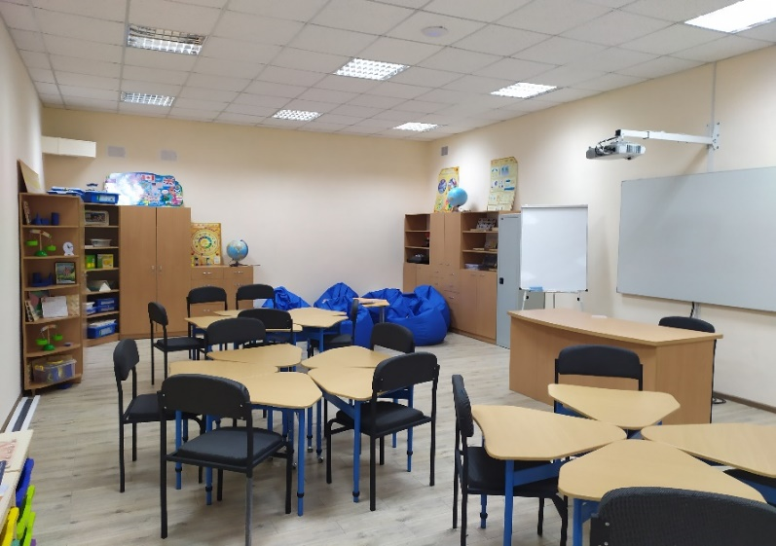
Additional results of the MoPED project
An additional result of the project “Modernization of pedagogical higher education by innovative teaching instruments – MoPED” on the requirements of the educational reform of the New Ukrainian School was the creation NUS – the innovative classroom.
The main purpose of this innovative class is to train future primary school teachers, as well as to improve the skills of practitioners on the concept of the new Ukrainian school.
It has 7 learning zones: news, communications, silence, thematic, materials, discovery, and teacher zone.
Also, on the basis of the innovative classrooms ICR and NUS was created Center for Supporting of Inclusive Education a Center for Continuing Education.

Slide 25
Erasmus+ CBHE Project UTTERLY “University Teachers' Certification Centres: Innovative Approach to Promotion Teaching Excellence”
Aim of the project: to contribute to the modernization of the system of higher education in Ukraine by introducing university centers of excellence to promote European educational innovation through professional certification of university teachers.
The UTTERLY project is a logical continuation of the previous MoPED project, as a result of which the Center for Continuing Education was established on the basis of the university. The implementation of the project will be an opportunity to modernize the existing structure, create the necessary conditions for the implementation and use of new European experience in the field of professional development of teachers in Ukraine in particular and educators in general.

Slide 26
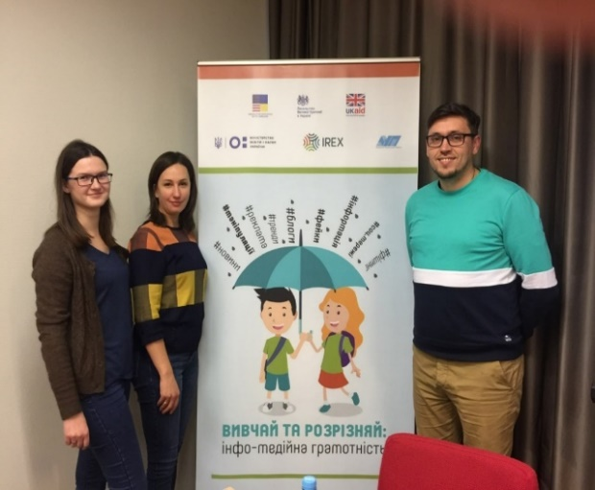
Project “Study and distinguish: info-media literacy”
The International Research and Exchanges Board (IREX) project “Study and distinguish: info-media literacy” was implemented in cooperation with the Ministry of Education and Science of Ukraine and the Ukrainian Press Academy with the support of the British and US Embassies, aimed at introducing innovative teaching methods for developing info-media literacy skills.
The project is designed to form skills for effective information retrieval; to teach how to find and work with sources and primary sources; to distinguish copyright and plagiarism, to perform fact-checking.

Slide 27
Cooperation with Guangdong University of Petrochemical Technology
In September 2020, cooperation between our Universities started from an online coordination meeting with the administration of our university and the rector of Guangdong University, conducted in order to determine the key areas of cooperation. Now between the institutions signed an agreement on cooperation, where the main areas of interaction defined science, education and culture.
For students and professors and lecturers of our HEI already started an online course in the Chinese language, which provides participants with the appropriate certificates.

Slide 28
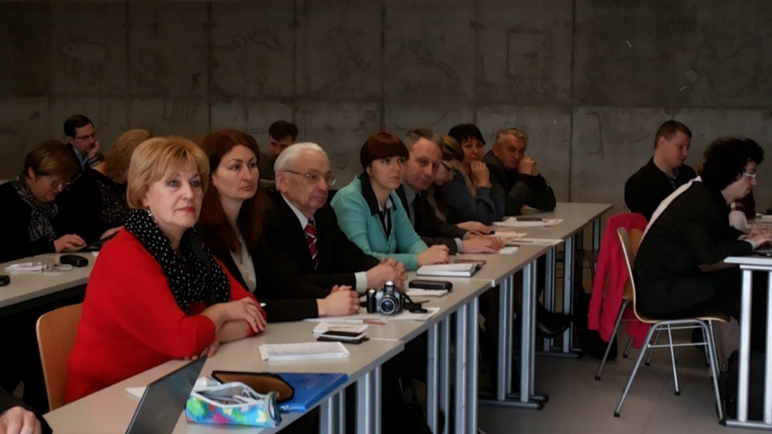
Tempus IV Project «Ecological Education in Ukraine, Russia and Belarus» (EcoBRU).
The project promotes the continuous training of vocational teachers and school teachers in Belarus, Russia and Ukraine. For this target group a program of electronic (so-called e-Learning) training – advanced training courses in the sphere of environmental education – was developed and implemented.

Slide 29
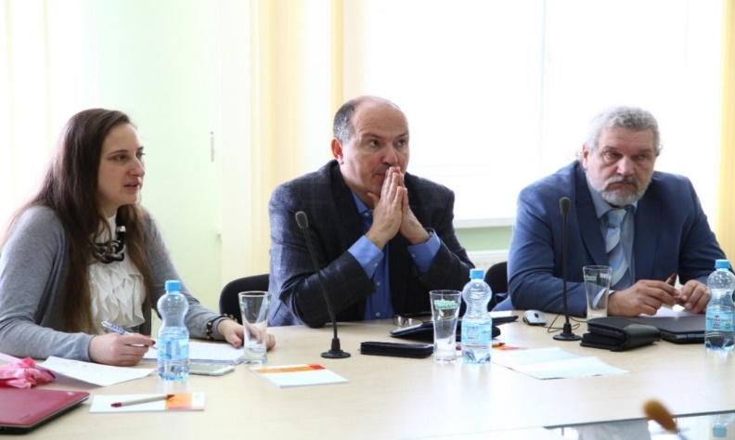
“Transfer of European experience in the fields of educational management , international cooperation with Pereiaslav-Khmelnytskyi Hryhorii Skovoroda State Pedagogical University”
Project “Transfer of European experience in the fields of educational management, international cooperation with Pereiaslav-Khmelnytskyi Hryhorii Skovoroda State Pedagogical University”, which was jointly conducted with the Center for School Management of the Faculty of Education of Charles University, Prague.
The aim of the project: improving the quality of teaching and functioning of the University through the transfer of Czech experience; preparation and implementation of a new course of school management; promoting the inclusion of the University to participate in international mobile programs.

Slide 30
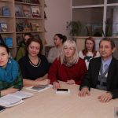
“Changes in pedagogical faculties and universities in the 21st century”
The project “Changes in pedagogical faculties and universities in the 21st century” is implemented by Masaryk University with the support of the Czech Development Agency and is a logical continuation of two previous projects “Educational Management” and “Inclusion in Educational Environment”.
The project is aimed at strengthening the capacity of the administrative and teaching staff of the HEI that prepares future teachers.
Planned types of activities:
active participation of university representatives in 5 educational trips to CR;
conducting seminars / workshops for university colleagues on the topics to be discussed in the Czech Republic;
participation in doctoral (postgraduate).

Slide 31
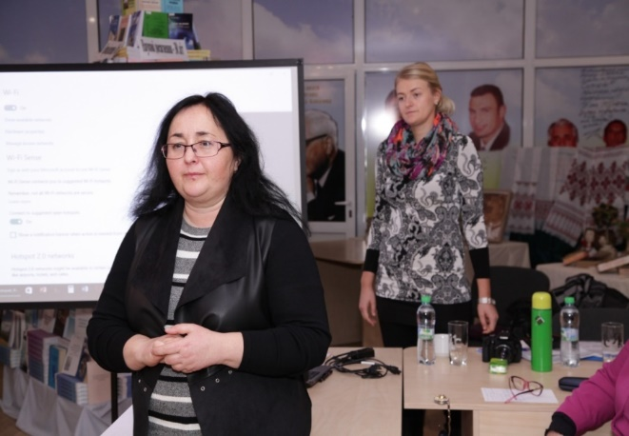
“Progressive University Management”
Project “Progressive University Management” is implemented by Czech Development Agency and Association for International Affairs.
The main goal of the project is to contribute to the development of higher education in Ukraine through the training of university representatives who are involved in areas that are important for the effective management of higher education institutions and internationalization.
The internship program included a cycle of trainings, lectures and practical seminars on the Czech higher education system and providing equal access to it. The basis for the first module of the internship was the Faculty of Education at Masaryk University.

Slide 32
Cooperation with the Istanbul Foundation for Science and Culture
received a grant for the implementation of new projects:
Erasmus+ (EU grant program) Youth project “Discovering and Sharing Common Human and Moral Values”
Erasmus+ (EU grant program) Youth project “Picture on the wall”
Erasmus+ (EU grant program) Youth project “Let’s write an utopia”
organized and held an exhibition of artistic works by students and teachers of the University “Hryhoriy Skovoroda and Said Nursi: humanistic horizons of the future” in the premises of the National Academy of Pedagogical Sciences of Ukraine

Slide 33
Erasmus+ Youth project “Discovering and Sharing Common Human and Moral Values”
The project will be implemented with our partners from Turkey, Lithuania, United Kingdom, Germany and Ukraine after the end of COVID-19 pandemic.
The aim of the project is to instill moral values in students, and to ensure that, upon graduation, students not only have the knowledge and skills needed to work and succeed, but also the compassion and emotional wherewithal to be a part of a safe, peaceful, and cooperative society.

Slide 34
Erasmus+ Youth project “Picture on the wall”
This project aims to increase the awareness of the participants about the social, cultural and intellectual life of the people living in Birecik Refugee Camps by increasing the awareness of the participants. Other objectives are the inclusion of individuals from different societies into the target group of the project by using the advantages of communication in internet and social media. Young people are expected to increase their ability to express empathy in case of unusual (migratory etc.) or ordinary situations and to diversify their ways of expressing themselves. In particular, it is aimed to know the place of effective use of communication technologies in today’s world.
The project will be implemented with our partners from Turkey, Lithuania, United Kingdom, Germany and Ukraine after the end of COVID-19 pandemic.

Slide 35
Erasmus+ Youth project “Let’s write an utopia”
This project will unite organizations from Ukraine, France, Hungary, Latvia, Bulgaria, Netherlands, Lebanon, Finland and Turkey to create a multinational consortium and introduce their vision of democratic successful society to participants willing to change the world to better.
The project will be implemented in Turkey after the end of COVID-19 pandemic.

Slide 36
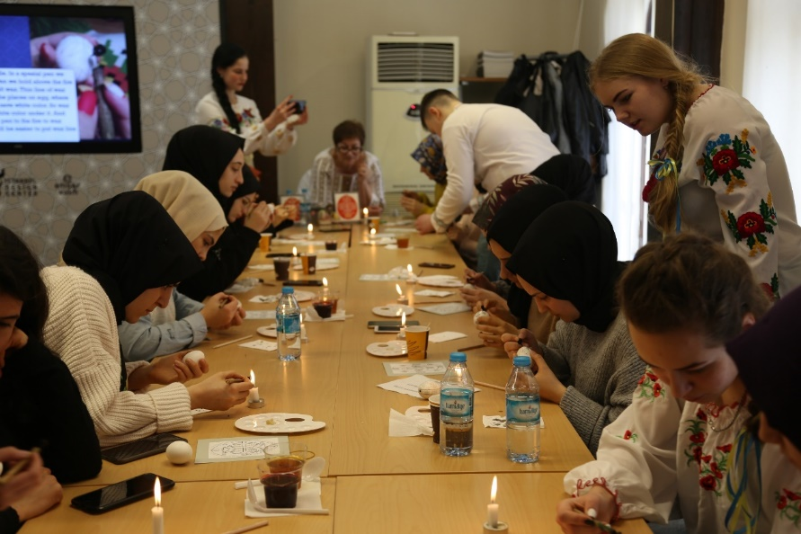
Erasmus+ Youth project “Tracing cultural heritage”
In early 2019, teachers and students of the university had the opportunity to participate in the project Erasmus+ “Tracing Cultural Heritage”, providing for the exchange of cultural heritage between different nations, the formation of modern youth multicultural competence, respect for the history of both their own people and neighboring states. The project was supported by the Turkish foundation Ensar Vakfi, the Center for Intercultural Communication and our University.
Ukrainian participants studied new artistic forms and technologies of traditional Turkish art, students received practice in Arabic calligraphy, tezheep and ebru. At the same time, the delegation from Ukraine presented a traditional Ukrainian people’s pysanok and invited colleagues from Turkey to practice working with paperplastic, vytynanky and decoupage.

Slide 37
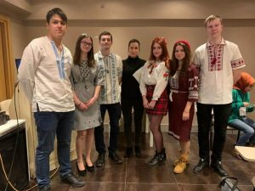
Erasmus+ Youth project “A Different Country – A Different Life”
Project Partners: Hungary, UK, Armenia, Ukraine, Turkey, Morocco
Aim of the project: to improve the conditions for international students studying in a foreign country
Duration: January 20-28, 2020.
Project results:
Discussion about improving conditions for international students;
Highlighting the problems they faced to a wider audience through social media, TV and radio;
Creating an adaptation system for other countries that host international students;
Informing students on improving their learning conditions and helping them in difficult situations.

Slide 38
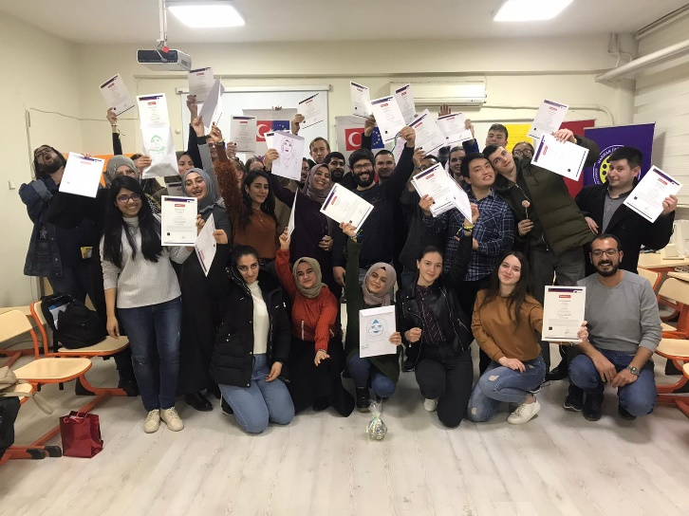
Erasmus+ Youth project “Unity is strength”
Partners: Moldova, Turkey, Lithuania and Ukraine
Duration: February 21-26, 2020.
The goal of the project is to minimize inequality in society and to create a friendly atmosphere.
The expected results and impact of our project:
Show that social cohesion has a national identity
To show the impact of peer age group on social participation
To examine group dynamics through emotional awareness
Prove that it is possible to live together
Take steps toward collective peace and promote awareness
Show that multiculturalism is beneficial
Show social cohesion without boundaries

Slide 39
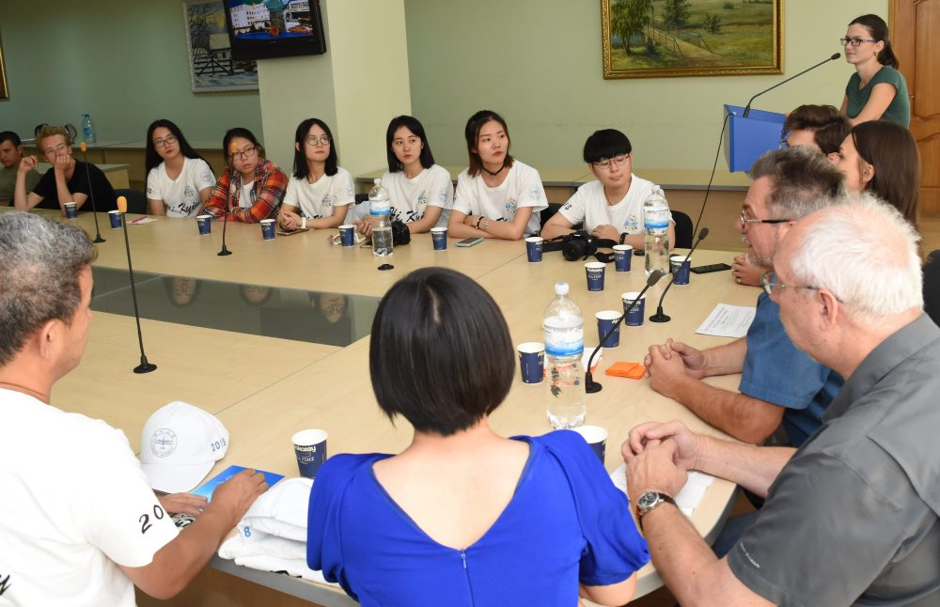
«Human rights, democracy, diversity and internationalization of Ukrainian society»
Conducting international student summer schools on the topic: «Human rights, democracy, diversity and internationalization of Ukrainian society» (2015-2018) in cooperation with the Danish Helsinki Committee for Human Rights.
The International Summer Student Camp has cognitive, developmental, educational, and cultural functions through seminars, workshops, discussion lectures, and psychological trainings. During the camp, students and teachers exchange teaching experience and build strong friendships with foreign comrades.

Slide 40
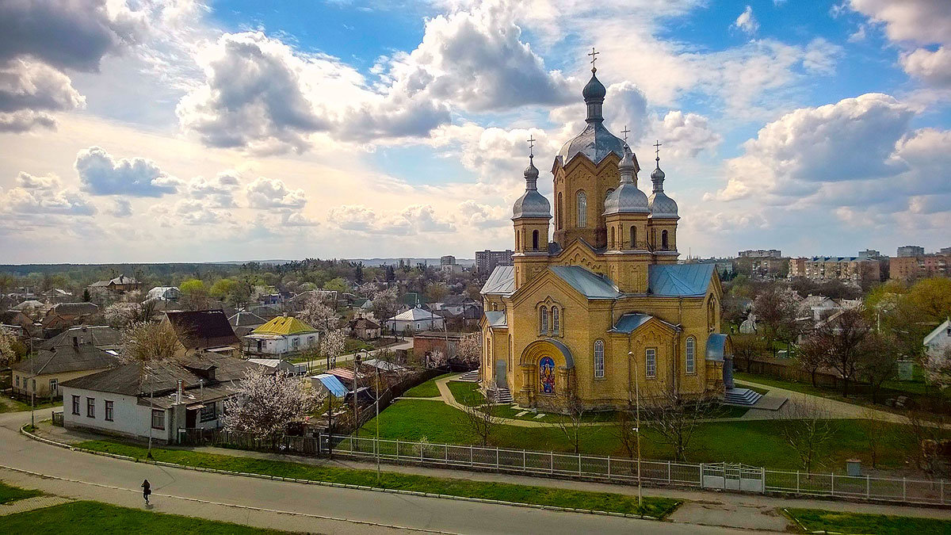
Pereiaslav

Slide 41
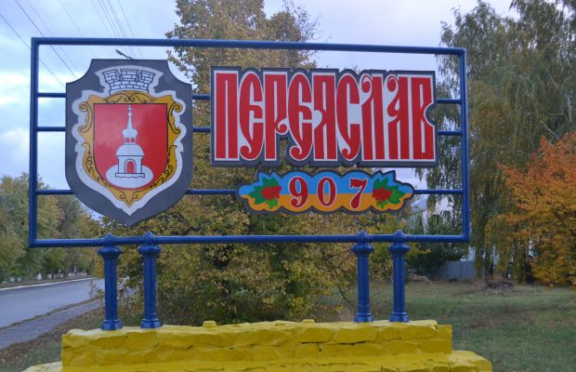
The first mention of the word «Ukraine» in the chronicle relates to Pereiaslav.
Pereiaslav is one of the oldest cities in Ukraine, first mentioned in written sources in 907. It is deservedly called the «museum Mecca of Ukraine», because it houses a record number of museums that introduce various aspects of life and culture of Ukrainians.

Slide 42
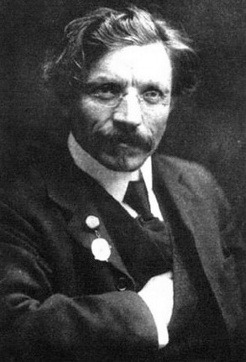
Famous persons
Sholem Aleichem
(Solomon Rabinovich)
Jewish writer, playwright, one of the founders of modern Yiddish fiction
A native of Pereiaslav
Louise Berliawsky Nevelson
American sculptor of Ukrainian descent (a native of Pereiaslav)
Became the first sculptor in whose honor in New York in Manhattan named the square - Louise Nevelson Plaza.

Slide 43
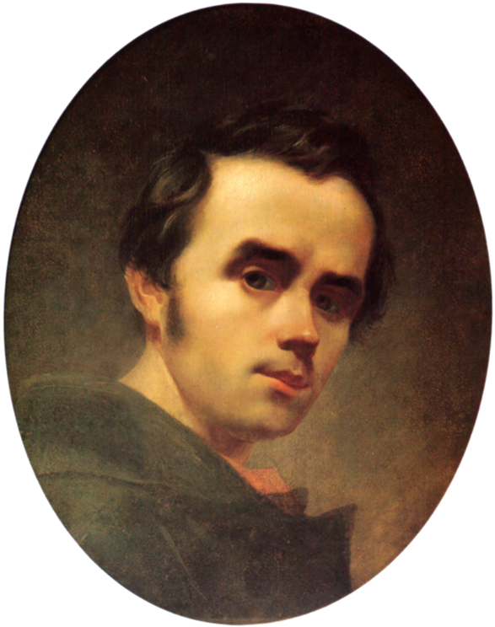
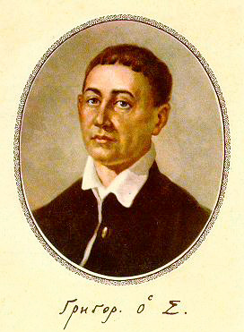
Famous persons
Taras Shevchenko
Ukrainian writer, classic of Ukrainian literature, thinker, artist. During his stay in Pereiaslav he wrote several works, including the famous «Testament» (1845).
In the house where the writer lived, the Museum of «Testament» of Taras Shevchenko was created.
Hryhorii Skovoroda
An outstanding Ukrainian philosopher-mystic, theologian, poet, teacher
Teacher of the Pereiaslav Collegium in the period from 1751 to 1753. The Hryhorii Skovoroda Memorial Museum was established in Pereiaslav in the former Collegium building.

Slide 44
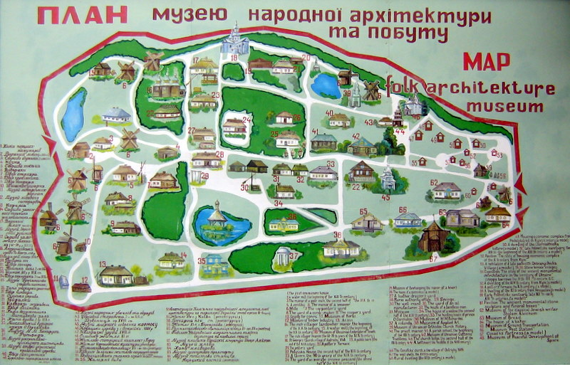
Museum of Folk Architecture and Life of the Middle Dnieper
Open-air museum located in Pereiaslav suburbs.
The museum presents both the Ukrainian village of the Middle Dnieper region of the late 19 - early 20 centuries, and buildings and parking lots from the late Paleolithic to the times of Kievan Rus. There are 13 thematic museums on the territory of 30 hectares, which are an organic continuation of the museum-village. The museum acquaints with folk culture, architecture and creativity, customs and rituals of Ukrainians of the Middle Dnieper region.
Schematic plan of the museum

Slide 45
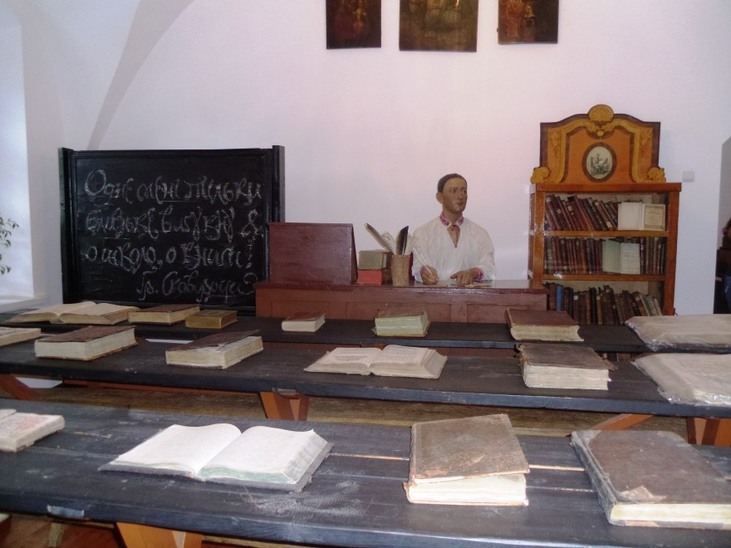
Hryhorii Skovoroda Memorial Museum

Slide 46
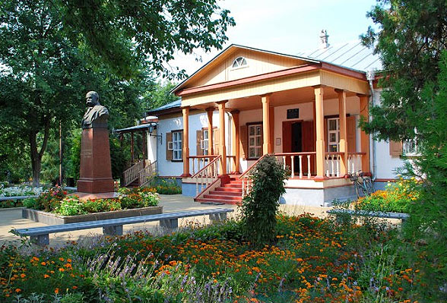
Museum of «Testament» of Taras Shevchenko

Slide 47
Thank you for attention!
Oksana Kovtun
Vice-Rector for International Relations and Project Activities
Tel.: +38 (073) 061-69-35
E-mail: kovtunok@ukr.net
Web-site of the University: https://phdpu.edu.ua/
Web-site of the International Relations Department: https://doir.phdpu.edu.ua/

